Slide 1
Oklahoma City Downtown Parking Management Study City Council Presentation – February 4, 2020

Slide 2
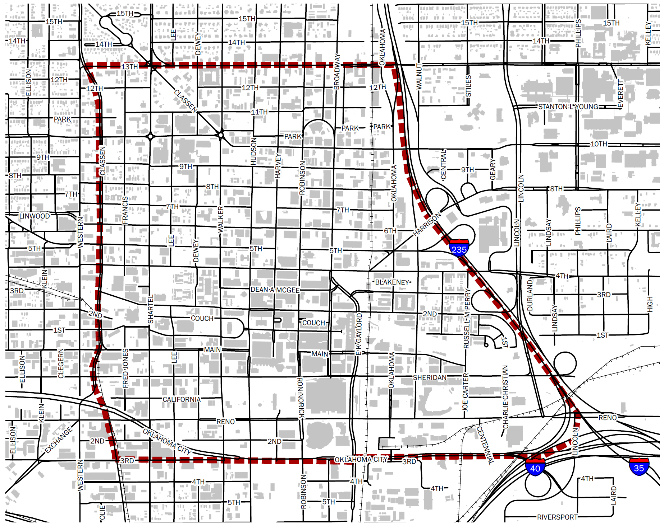

Slide 3
Today’s Agenda
Project Purpose and Process
What We Learned
Updated Approaches to Parking Management
Primary Recommendations

Slide 4
Goals and Objectives
Foster an open and inclusive process with area stakeholders
Balance on-street and off-street parking demands
Continuously improve parking management procedures and policies
Enhancing technology to provide real time parking information
Provide structures to guide decision making
Investigate opportunities for on-street revenue sharing
Determine and locate supply-demand surpluses or deficits today and in the future

Slide 5
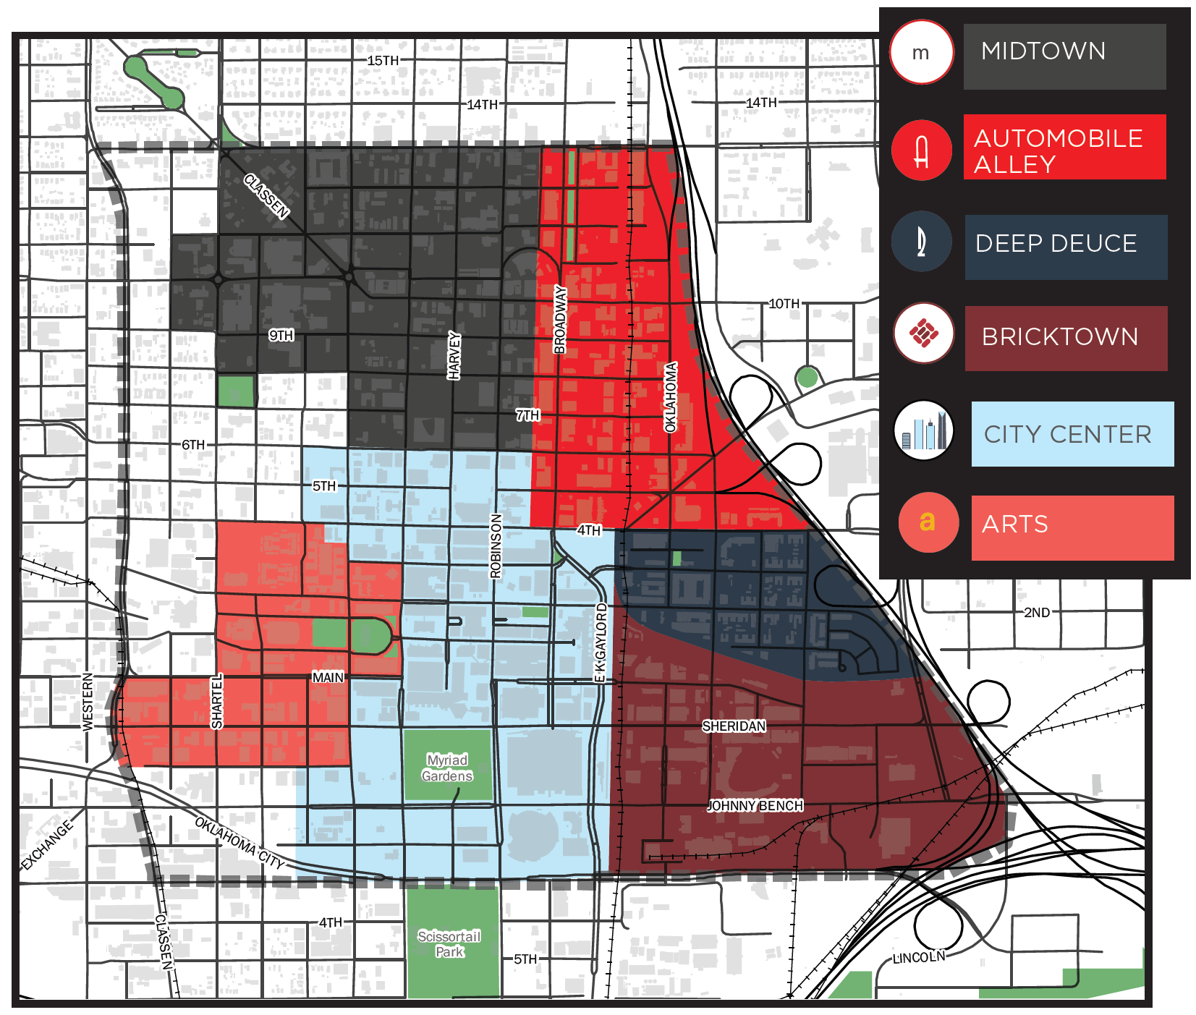

Slide 6
Project Process
Define
Diagnose
Treat
Project orientation
Initial stakeholder outreach
Online surveys
Data collection
Existing needs analysis
Future needs analysis
Traffic and parking analysis
Strategy testing
Public outreach
Modeling
Balance on-/off-Street demands
Draft recommendations discussions
Downtown Parking Management Strategy
Implementation Plan
Presentations to leadership

Slide 7
What We Learned

Slide 8
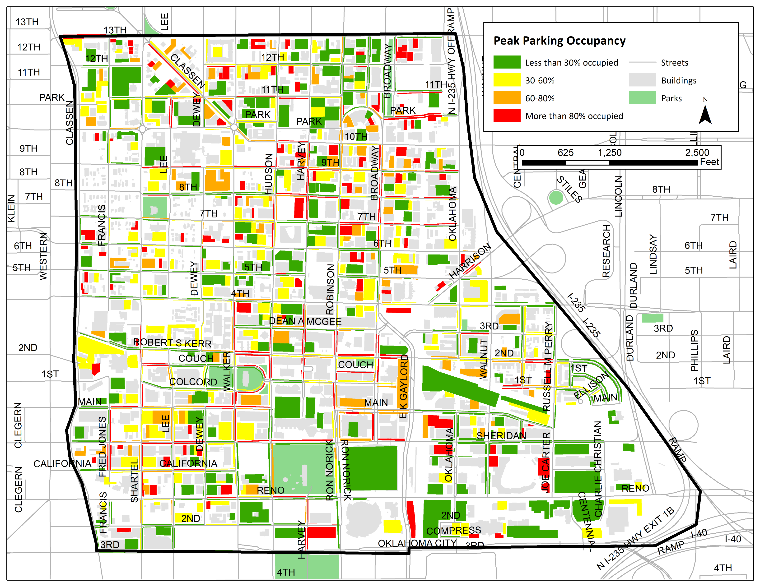
Study Area Parking Occupancy
(12pm-3pm)

Slide 9
Parking by the Numbers
All districts experienced peak occupancy in 12-3pm range except for Bricktown (3-6pm)
The total peak parking occupancy for the study area is 36%
Free On-Street
40% occupied
Paid On-Street
52% occupied
Public Parking – Public Access
40% occupied
Private Parking – No Public Access
36% occupied
Private Parking – Public Access
38% occupied

Slide 10
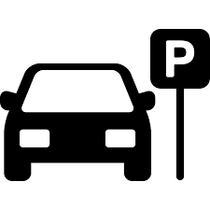
Parking by the Numbers
36,881 off-street parking spaces
186 acres of unused parking
1,200 acres Downtown
256 acres of parking
23,137 spaces empty at peak conditions
141 football fields of unused parking

Slide 11
Primary Observations
Off-street parking is heavily underutilized and over built by the private sector
On-street parking has dynamic demand needs
Enforcement is inconsistent
Parking management needs to modernize in certain areas
Evolving districts and neighborhoods require unique solutions
Parking & mobility should be intertwined to support a vibrant community

Slide 12
Primary Recommendations

Slide 13
Shared Parking
Leverage vast available parking supply throughout the study area and individual districts to develop a more structured public parking system
Intended Benefits
Potential Challenges
Create a more cohesive parking system
Support future growth
Create a better balance between on-street and off-street parking
Revenue Sharing
Initial support from the private sector for participation
Defining appropriate locations
Investment in wayfinding, technology, and operations needed

Slide 14
Improved Enforcement Options
Consistent, modern, and effective enforcement can be a pivotal catalyst for improving overall parking management and system performance
Intended Benefits
Potential Challenges
Improved parking turnover and access to parking in high demand areas
Better balance between on-street and off-street utilization
Improved compliance with regulations
Could be perceived as heavy-handed approach to parking management
Citation issuance needs to be balanced with education

Slide 15
Further Consideration: Parking Benefit Districts
Collaborative approach to district parking management that uses paid parking as a proxy to both improve parking efficiency and reinvest into the neighborhood
Intended Benefits
Potential Challenges
Promote shared use of parking
Balanced utilization of all parking assets
Neighborhood reinvestment
Support from residents and businesses
Generation of enough revenue to support sharing of parking revenues

Slide 16
Data-Driven Policies to Support Balanced Utilization
Used to justify and encourage dynamic price and policy, improve marketing, wayfinding, and branding, and create better connectivity within the community
Intended Benefits
Potential Challenges
Reduced congestion in high demand areas/facilities
Better utilization of parking facilities
Better decision-making in commute choice
Setting the correct price to define behavior
Enabling over-population of certain facilities
Ongoing data management and policy changes

Slide 17
Data-Driven Policies to Support Balanced Utilization
Used to justify and encourage dynamic price and policy, improve marketing, wayfinding, and branding, and create better connectivity within the community
City Center
Bricktown
Midtown & Auto Alley
Raise on-street parking pricing by $0.50 per hour to balance demand between on-street and off-street
Extend enforcement hours to support evening & weekend activity. Implement event-based parking rates.
Implement paid parking in primary destination areas, including: Broadway Avenue, Classen Drive, Walker Avenue and others. Price should be set to current rates and evaluated yearly.
Prices and policy should be evaluated annually and adjusted to encourage balance in the parking system

Slide 18
Primary Recommendations
Short Term Year 1
Implement mobile pay platform
Implement demand-based pricing changes
Mid Term Years 1-4
Create and expand shared parking network
Create code changes that support shared parking
Long Term > Year 4
Expand shared parking
Consider TDM & Modern Mitigation strategies
Implement new paid parking areas
Modernize and transition enforcement
Evaluate Downtown Benefit District
Evaluate performance metrics and program success
Evaluate commercial/neighborhood parking policies
Consider district-based mobility investments

